Slide 1
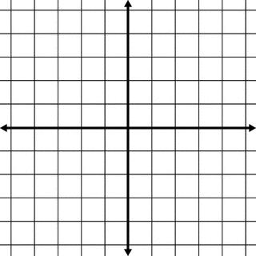
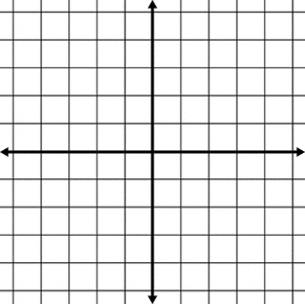
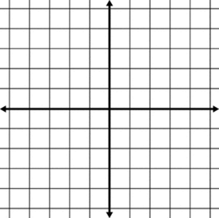
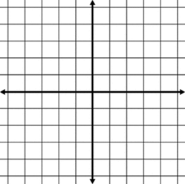
TYPES OF TRANSFORMATIONS
Translations: ________________________________________ ________________________________________________________________________________________________________________________________________________________________________ | Reflections: _________________________________________ ________________________________________________________________________________________________________________________________________________________________________
Rotations: ______________________________________________ _______________________________________________________________________________________________________________________________________________________________________________________ | Dilations: _______________________________________________ _______________________________________________________________________________________________________________________________________________________________________________________
Plot: A(4,4) B(-3, 2) C(-1,5)
Translate the shape 2 units to the left and 5 units down (x, y)
(+2, -5)
Remember to add the “prime” mark to your new points: A’, B’, C’
THESE IMAGES ARE ______________!
Reflection over the x-axis
What changes? (x, y)
Reflection over the y-axis
What changes? (x, y)

